Slide 1
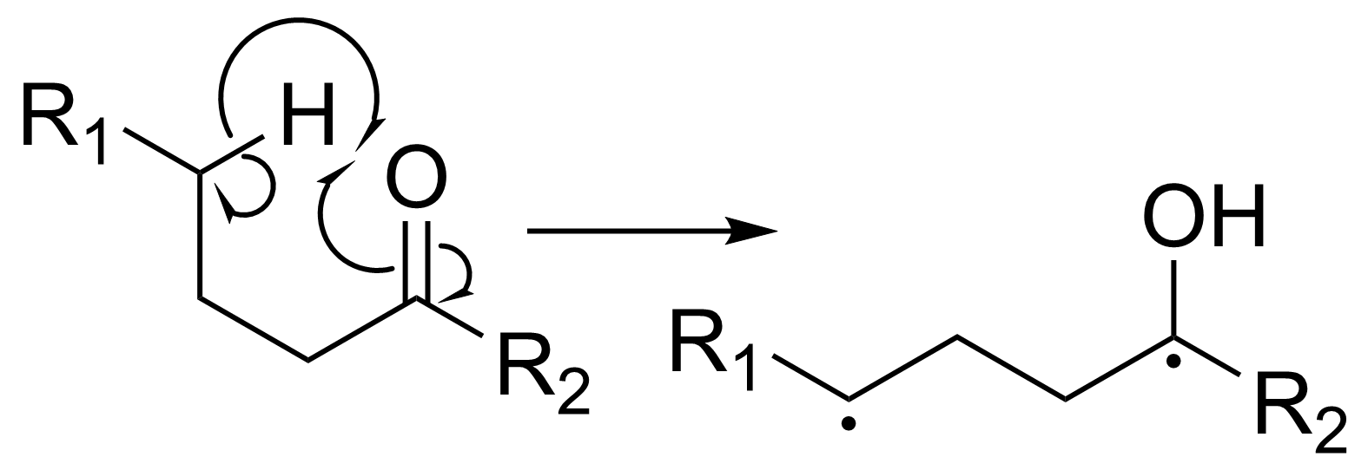
The Norrish Type II reaction
(γ-H abstraction)
Keiran Rowell - Group Meeting - 30th Nov 2018

Slide 2
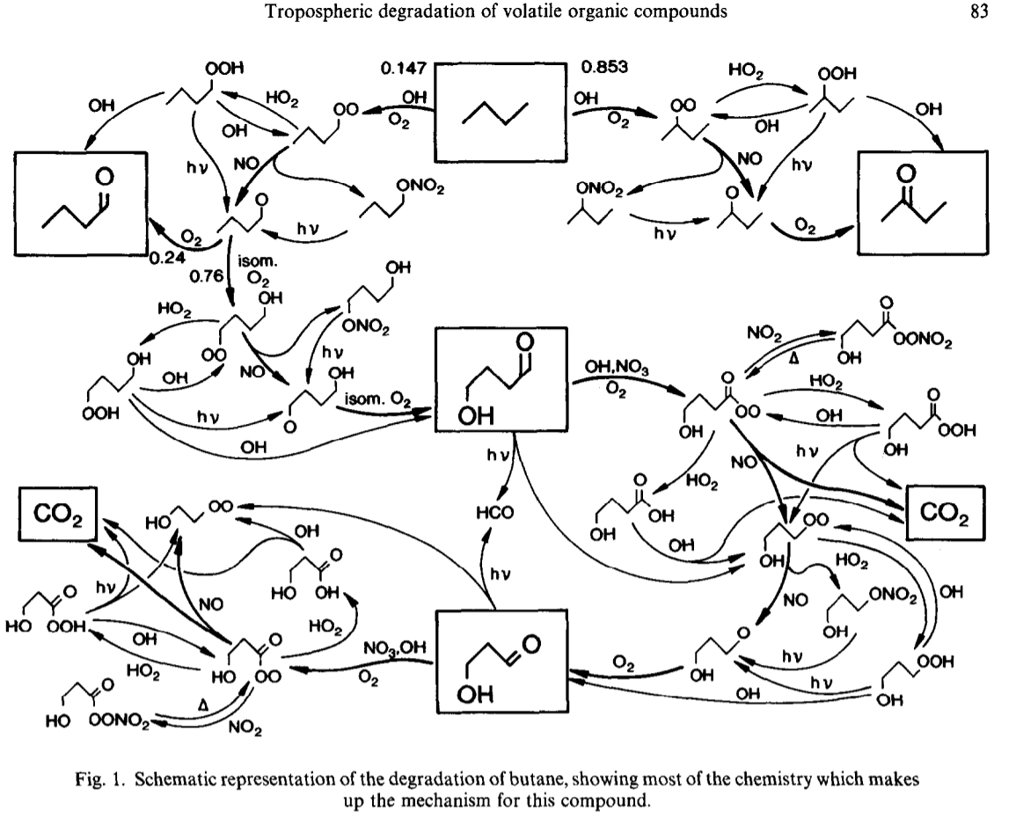
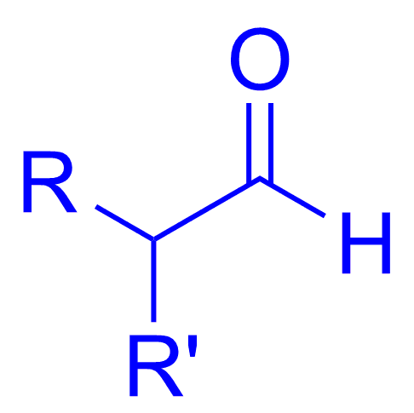
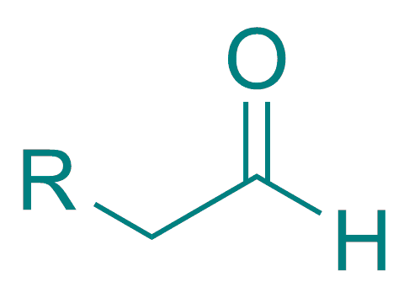
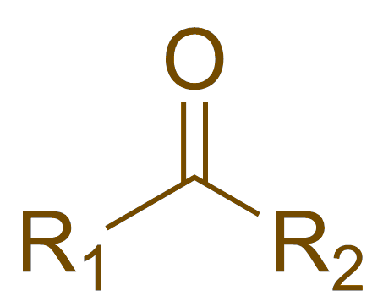
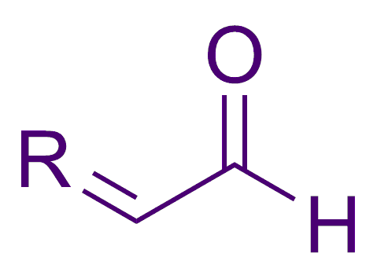
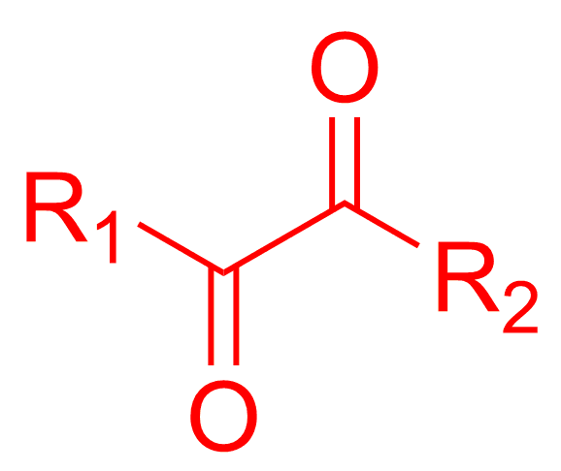
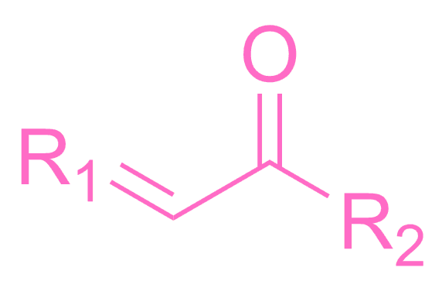
Photoch
Carbonyls in the atmosphere
Jenkin M., Saunders S., Pilling M., Atmospheric Environment, 1997, 31, 81-104
Linear aldehydes
Branched aldehydes
Ketones
Enals
Enones
Dicarbonyls

Slide 3
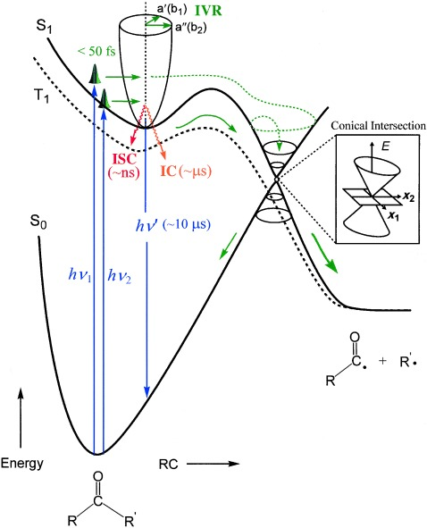
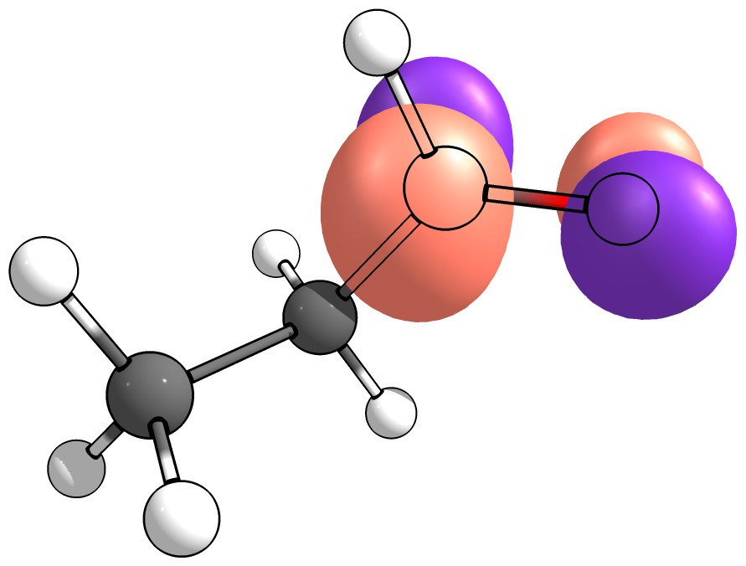
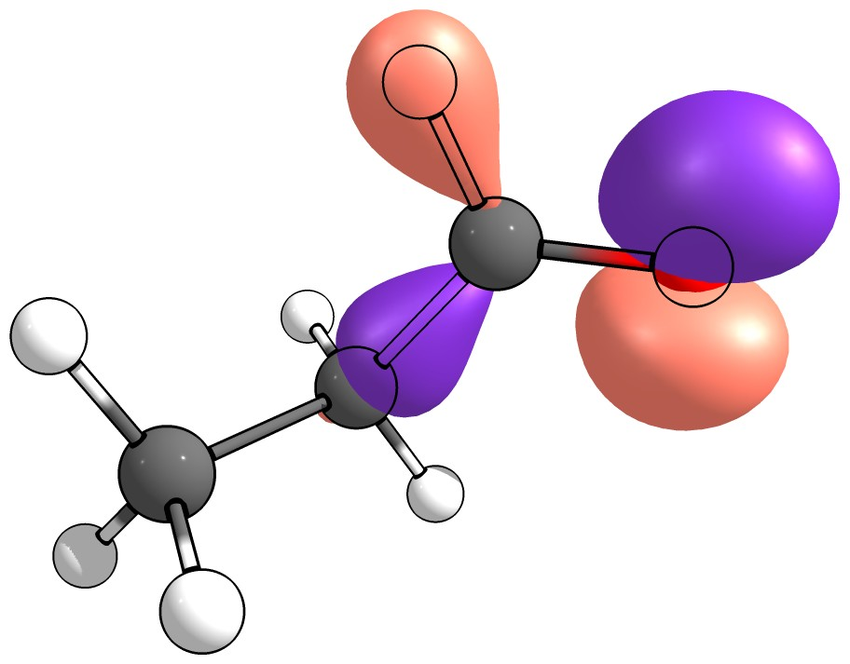
NTI photochemistry
Heicklen J., J. Am. Chem. Soc. 1959, 81, 3863–3866
Corrigan M. “Modelling the photochemistry of acetaldehyde” 2015 [Honours Thesis]
Diau E. W-.G., Kötting C., Zewail A., CHEMPHYSCHEM, 2001, 2, 273-293
π*
hν
n

Slide 4
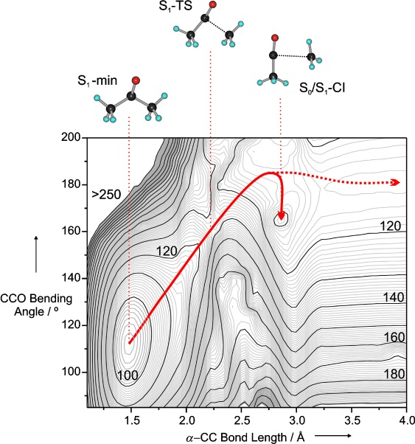
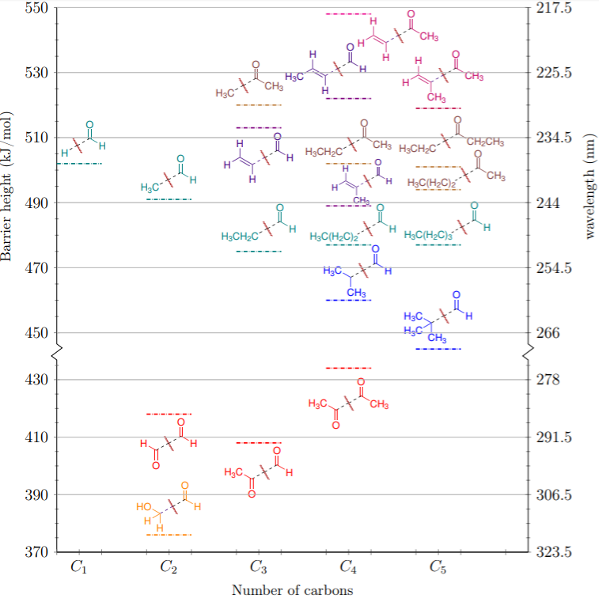
S₁ and NTI
Rowell K., Kable S., Jordan M., “Substituent effects on the α-bond cleavage of photochemically important carbonyls”, [in preparation]
Diau E. W-.G., Kötting C., Zewail A., CHEMPHYSCHEM, 2001, 2, 273-293
Accessible range

Slide 5
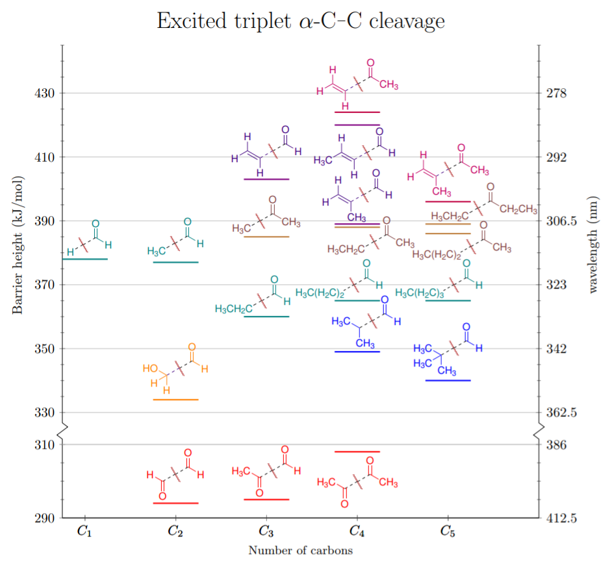
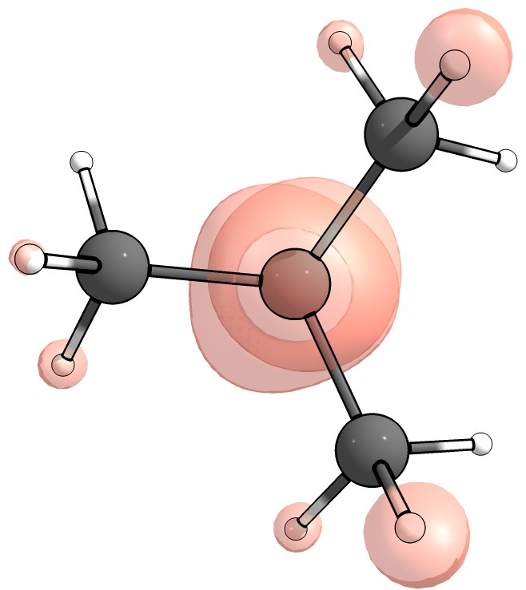
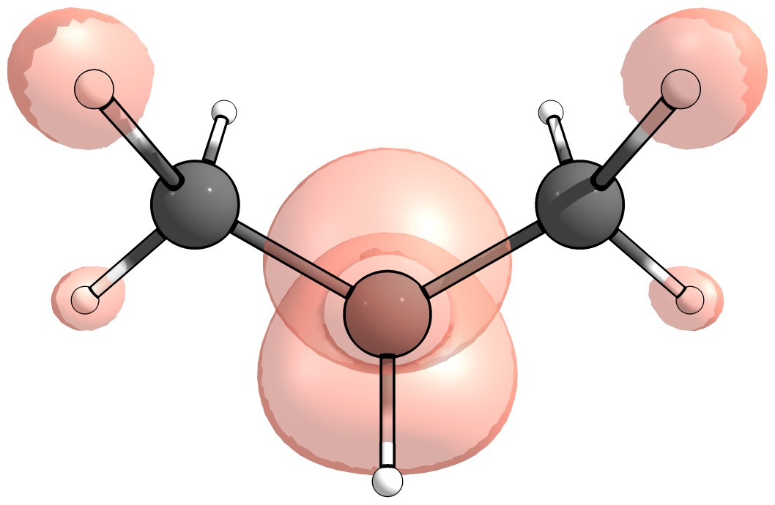
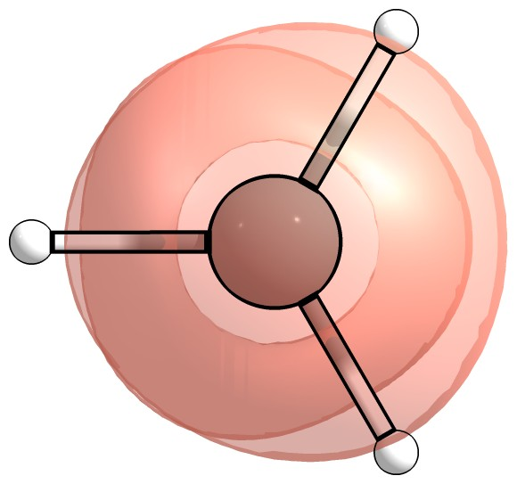
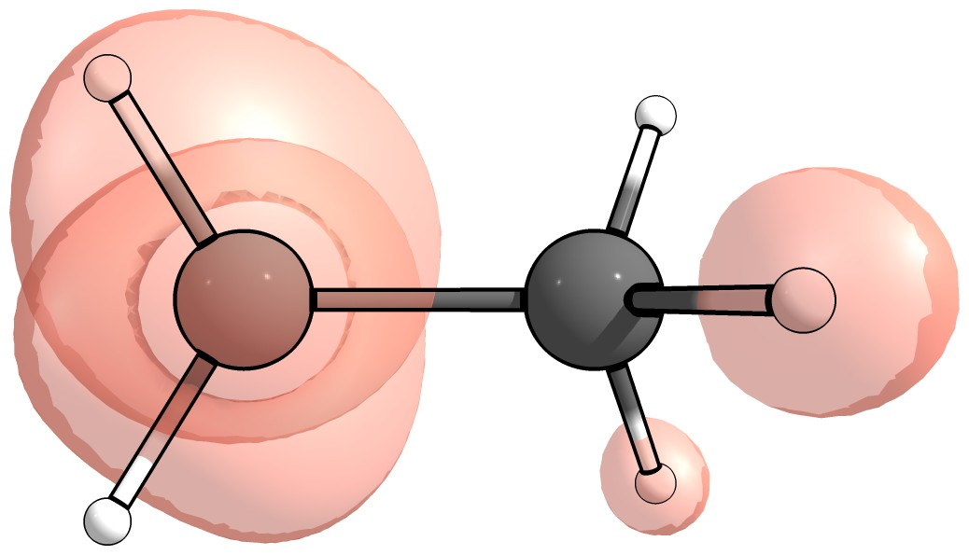
What factors affect NTI?
Rowell K., Kable S., Jordan M., “Substituent effects on the α-bond cleavage of photochemically important carbonyls” [in preparation]
Branching vs Conjugation
Hyperconjugation
α-substitution

Slide 6
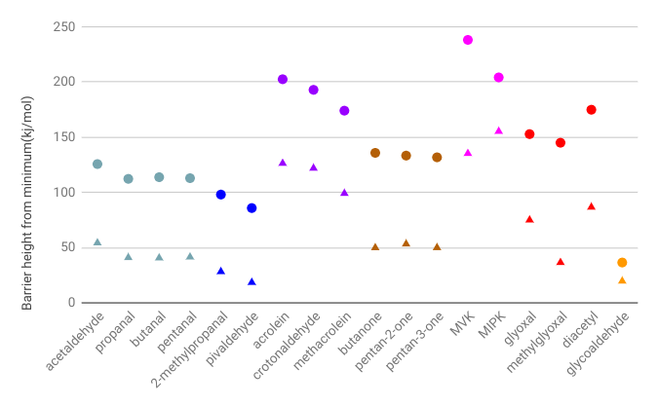
NTIa on S₁ (●) vs T₁ (▲)
Intrinsic barriers
Rowell K., Kable S., Jordan M., “Substituent effects on the α-bond cleavage of photochemically important carbonyls” [in preparation]
► S₁ & T₁ show same trends
► S₁ shifted higher ~50 kj/mol
► ‘0-0’ excitation energy diff.
► •H & •CH₃ NTIb basically flat
► SARs describe all surfaces!

Slide 7
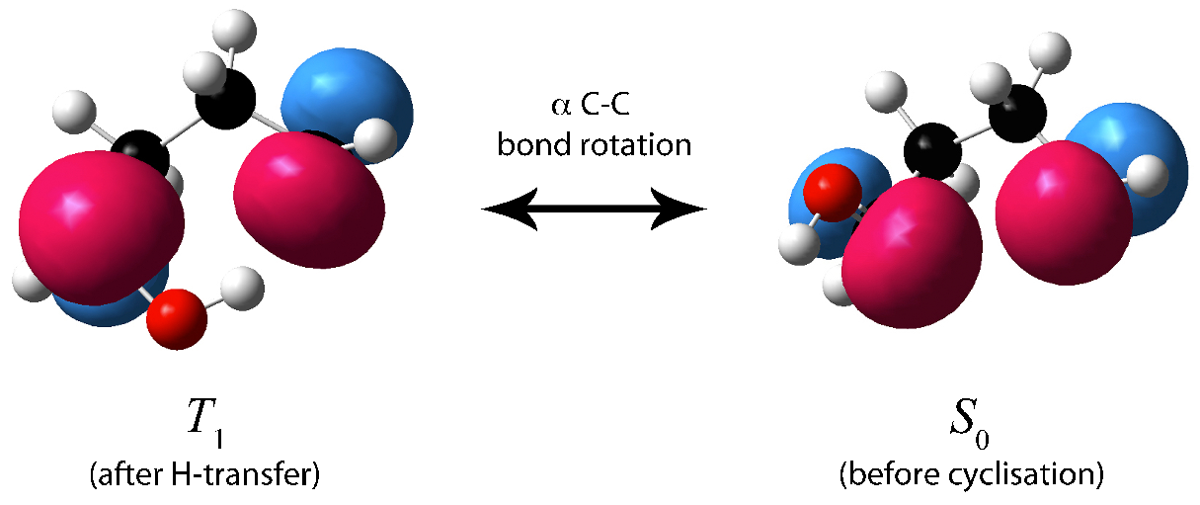
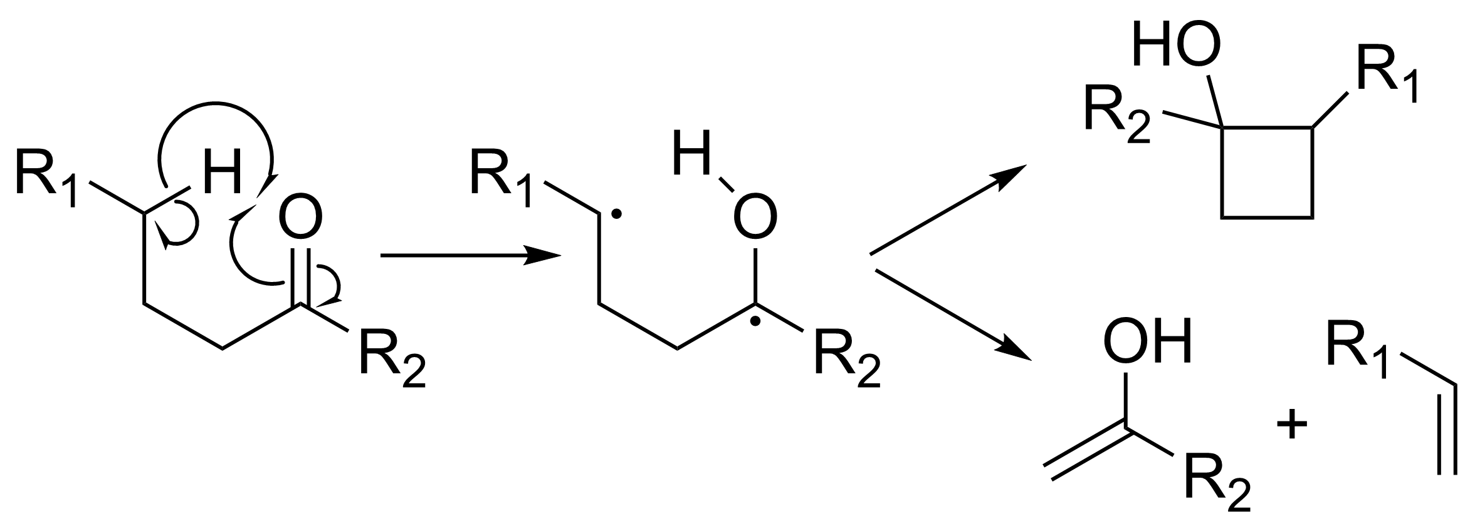
The NTII pathways
De Feyter S., Diau E. W.-G., Zewail A., Angewandte Chemie, 2000, 39, 260-263
Shaw M. “Photochemical Formation of enols from carboyls” 2017 [PhD Thesis]
IUPAC. Compendium of Chemical Terminology, 2nd ed. (the "Gold Book"). Compiled by A. D. McNaught and A. Wilkinson. Blackwell Scientific Publications, Oxford (1997). XML on-line corrected version: http://goldbook.iupac.org (2006-) created by M. Nic, J. Jirat, B. Kosata; updates compiled by A. Jenkins. ISBN 0-9678550-9-8. https://doi.org/10.1351/goldbook.
Norrish-Yang Cyclisation
Conformationally limited
γ-H abstraction
Enol + Alkene

Slide 8
Surface(s) of NTII?
Michael J., Noyes W., JACS, 1963, 85, 1027-1032
O’Neal H., Miller G., Gunderson E., JACS, 1974, 96, 3351-3357
Stephenson L., Cavigli P., Parlett J., JACS, 1971, 93, 1984-1988
Tolgyesi M., Nacsa A., J. Photochem., 1979, 11, 333-345
Wagner P., Hammond G., 1965, 87, 4009-4011
Chen B., Fang W., Chem. Phys. Lett., 2002, 361, 472-482
Shaw M. “Photochemical Formation of enols from carboyls” 2017 [PhD Thesis]
De Feyter S., Dia E. W.-G., Zewial A., Angewandte Chemie, 2000, 39, 260-263
Surface is molecule-dependent
►Tertiary or secondary γ-H stabilised by hyperconjugation.
▻ Rapid S₁ ∴ unquenchable.
▻ C-H bond strength, deuteration
▻ Femtosecond-MS & DFT
▻ α-C radical stabilisation
▻ ISC same, diff. is chemical
► Triplet scrambles stereochemistry
►Singlet has some scrambling
► Quenching studies used to distinguish between S₁ & T₁ reactivity
▻ Experiments conducted at 380-385 kJ/mol
►Different species showed different quenching sensitivity:
▻ hexan-2-one: singlet
▻ pentan-2-one: triplet
▻ butanal: equal parts singlet & triplet
► The triplet biradical has a µs lifetime and can be trapped.

Slide 9
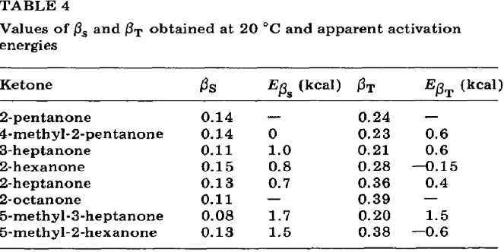
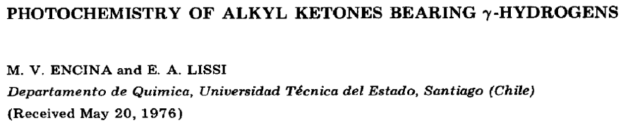
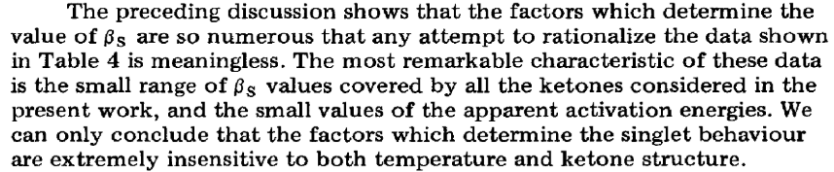
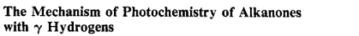
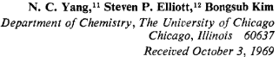
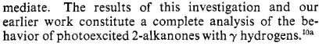
Rationalising NTII
Yang N., Elliot S., Kim B., JACS, 1969, 91, 7551-7553
Shaw M. “Photochemical Formation of enols from carboyls” 2017 [PhD Thesis]
Encina M., Lissi E., Journal of Photochemistry, 1976, 6, 173-181

Slide 10
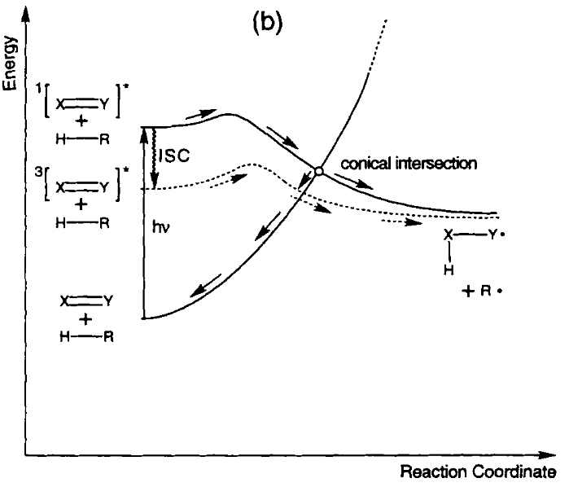
The NTII conical intersection
Shaw M. “Photochemical Formation of enols from carboyls” 2017 [PhD Thesis]
Nau W., Ber. Bunsenges. Phys. Chem, 1998, 102, 476-485
► ‘Absolute reactivity of S₁ exceeds T₁ , but S₁ is chemically less efficient due to radiationless deactivation’
► S₁ deactivation > 80%
► CI competitive with dissociation, H-back transfer, ISC
► Conical intersection following the TS — common to a range of H-abstraction reactions
► Requires a CAS calculation (multistate optimisation)

Slide 11
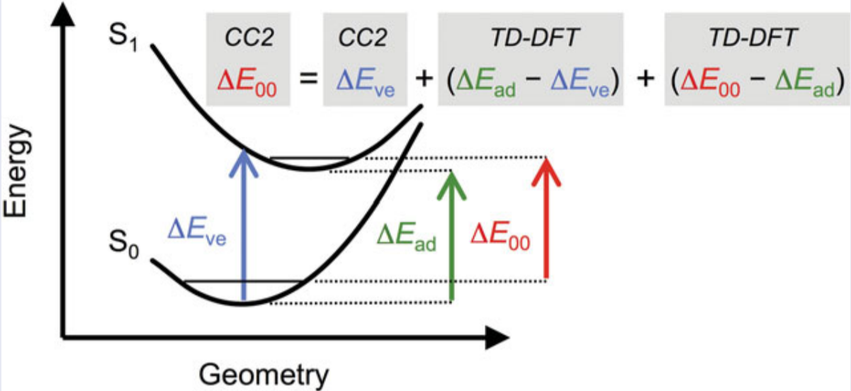
S₁ calculations
Orgunati B., Fang C., Durbeej B., Molecular Physics, 2016, 114, 3348-3463
Issues with S₁ and NTII
► Needs to distinguish close S₁ & T₁ barriers
► NTII process has involved CI — TD-DFT can fail
► NTII molecules C₄+ — EOM-CC scales badly!
► H-transfer reaction — need high E_{x}^{HF} exchange
▻BH&HLYP bumps E_{x}^{HF} up to 50% — still fails
▻Meta-functionals (M06-2X) expensive for TD
▻Use range-separated hybrids (CAM-B3LYP)
✓ TSs found! Need to use same ZPVE in all
Excited state calculations are a pain
T₁ is lowest spin-unpaired solution — can use unrestricted
TD-DFT is inaccurate (~¹/₁₀ eV) — use composite procedure

Slide 12
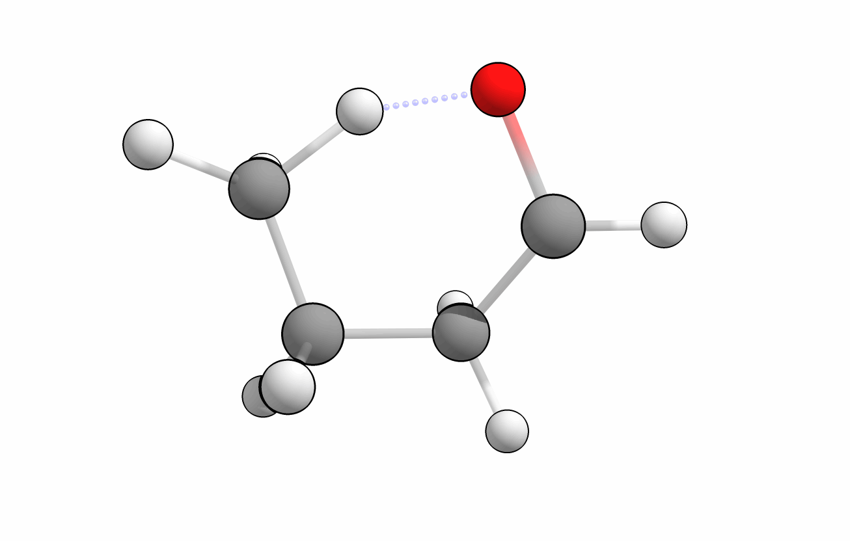
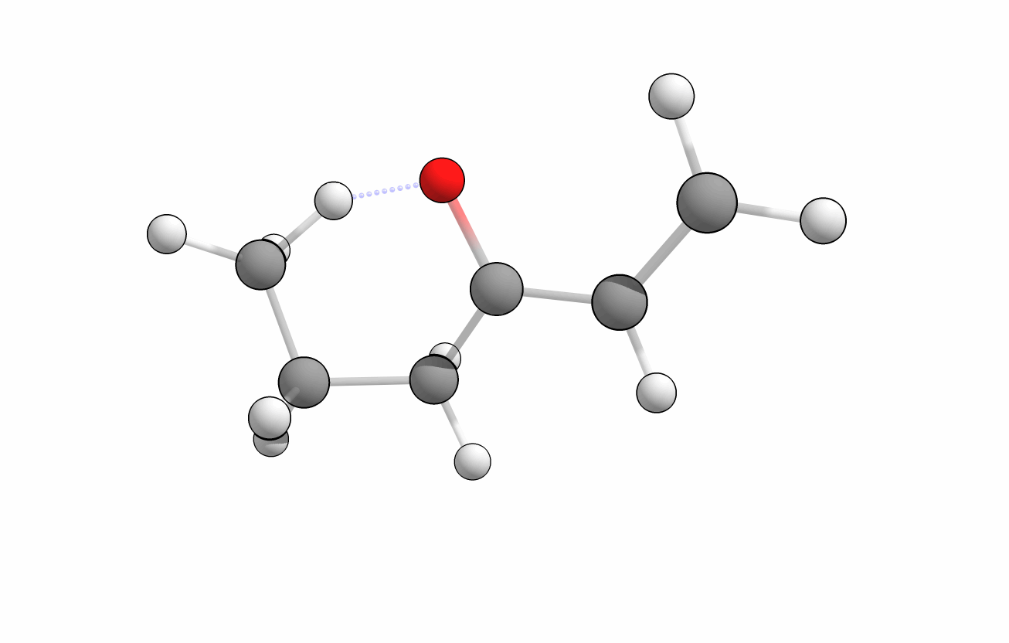
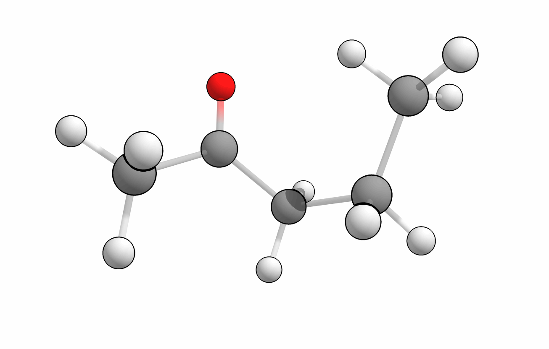
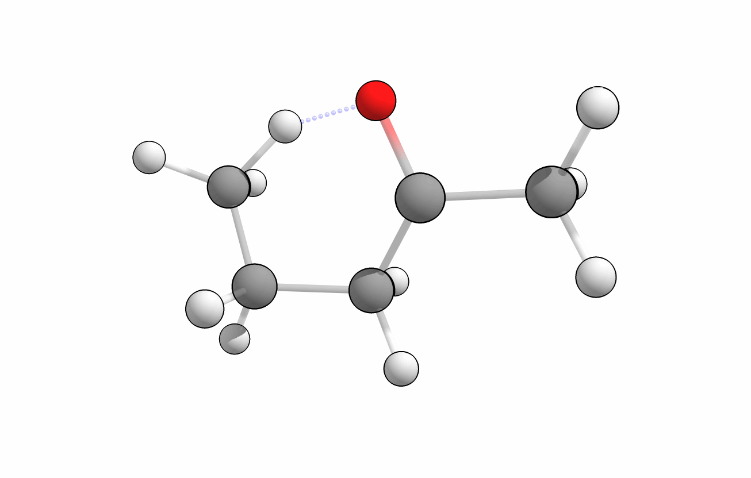
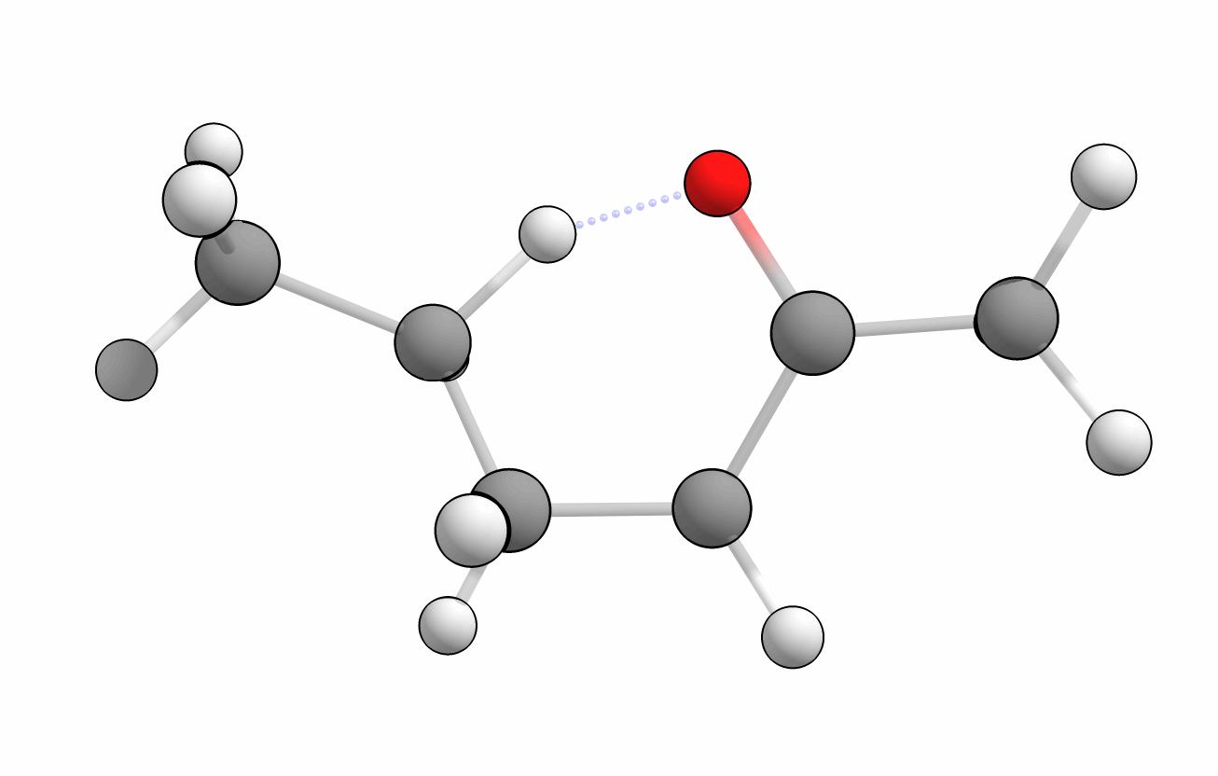

Slide 13
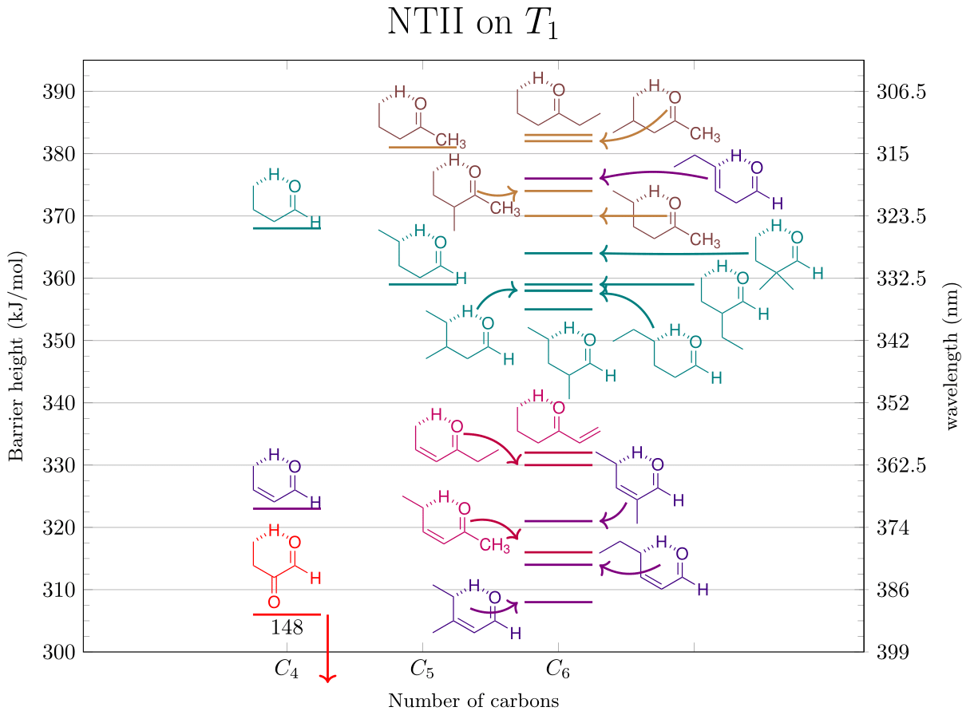
SARs of NTII

Slide 14
NTII barriers from S₁ min
Kletskii M., Lisovin A., Burov O., Kurbatov S., Comp. Theo. Chem., 2014, 1047, 55-66
► Still waiting on EOM-CC calcs — don’t have absolute energies
► S₁ intrinsic barriers are very low, > 30 kJ/mol — ~20 kj/mol lower than T₁
► In absolute energy terms, conjugation should lower the excitation energy
▻ primary ɣ-C ketones and aldehydes should be highest barriers
▻ enones and enals should have low absolute barriers, secondary & tertiary even more so

Slide 15
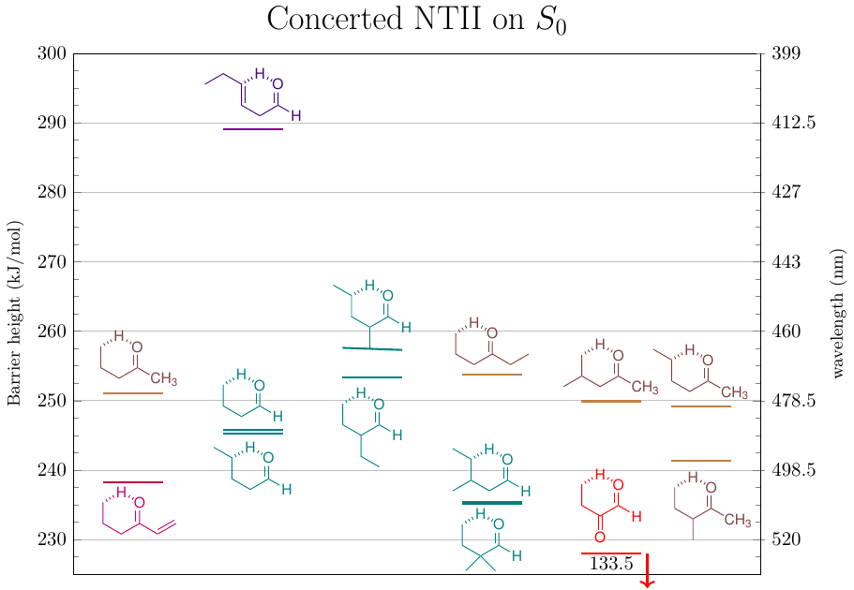
S₀ reaction?

Slide 16
Thank you!

Slide 17
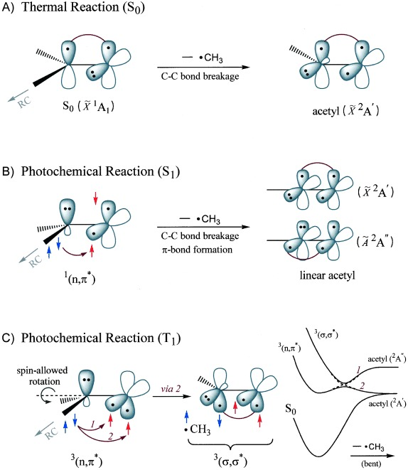
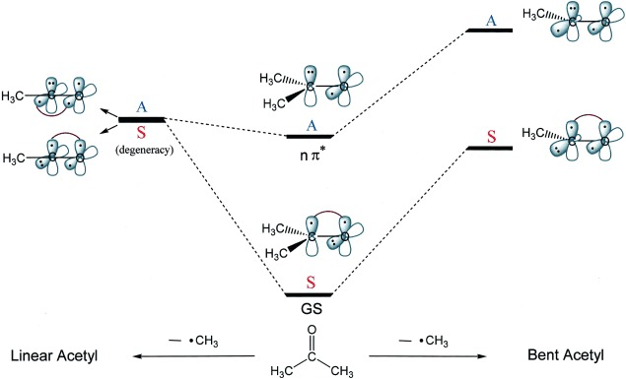
State correlation diagrams

